Slide 1
6.1
Inflation

Slide 2
Inflation -
Inflation is the continuous rise in general price level after full employment level of output.

Slide 3
Nature of inflation -
Inflation is a macro-economic phenomenon
It is measured as a rate of change in general price level over the years
Inflation decreases the value of money
Effect of inflation depend upon the rate of inflation
Various price indices try to measure the rate of inflation – Ex - Consumer price index
Inflation is measured by comparing the current price level with the base year

Slide 4
Measurement of inflation
Price Index –
Consumer Price Index (CPI) – Movements in consumer prices or retail prices are captured in the CPI – CPI (IW), CPI (NMUE), CPI (AL), CPI (Rural/Urban/Combined)
Producer Price Index (PPI) -
Wholesale Price Index (WPI) – It measure the movements in the wholesale prices.
GDP Deflator – It shows the cost of purchasing the items included in the GDP during the period relative to the cost of purchasing those same items during the base year.

Slide 5
Inflation in India – weighting of CPI Combined (Rural + Urban) – base year 2010
Groups | Weight (%)
Food, beverages & tobacco | 49.71
Fuel & light | 9.49
Clothing, Bedding & footwear | 4.73
Housing | 9.77
Miscellaneous | 26.31
All groups | 100.00

Slide 6
No. 18: Consumer Price Index (Base: 2010=100)
Group/Sub group | 2013-14 |  |  | Rural |  |  | Urban |  |  | Combined
 | Rural | Urban | Combined | Aug. 13 | Jul. 14 | Aug. 14 | Aug. 13 | Jul. 14 | Aug. 14 | Aug. 13 | Jul. 14 | Aug. 14
 | 1 | 2 | 3 | 4 | 5 | 6 | 7 | 8 | 9 | 10 | 11 | 12
1 Food, beverages and tobacco | 138.8 | 138.0 | 138.6 | 138.2 | 149.0 | 151.4 | 140.2 | 149.7 | 151.9 | 138.8 | 149.2 | 151.6
1.1 Cereals and products | 132.8 | 131.9 | 132.6 | 131.2 | 140.6 | 141.5 | 131.3 | 138.0 | 139.2 | 131.2 | 139.9 | 140.9
1.2 Pulses and products | 118.2 | 115.2 | 117.3 | 117.3 | 123.8 | 124.8 | 113.8 | 120.8 | 122.9 | 116.2 | 122.9 | 124.2
1.3 Oils and fats | 143.9 | 141.9 | 143.2 | 142.9 | 146.1 | 146.1 | 141.8 | 138.1 | 138.0 | 142.5 | 143.5 | 143.5
1.4 Egg, fish and meat | 143.1 | 146.8 | 144.4 | 142.4 | 153.2 | 153.7 | 147.0 | 156.3 | 157.8 | 144.0 | 154.2 | 155.1
1.5 Milk and products | 144.2 | 139.0 | 142.3 | 142.2 | 156.3 | 158.1 | 136.9 | 153.1 | 154.0 | 140.2 | 155.1 | 156.6
1.6 Condiments and spices | 134.3 | 132.9 | 133.9 | 132.9 | 141.2 | 142.5 | 131.5 | 147.8 | 150.6 | 132.5 | 143.1 | 144.9
1.7 Vegetables | 161.5 | 157.5 | 160.3 | 167.8 | 185.5 | 199.6 | 186.1 | 189.8 | 200.4 | 173.6 | 186.9 | 199.9
1.8 Fruits | 155.8 | 147.2 | 152.1 | 150.3 | 183.2 | 185.7 | 144.7 | 181.0 | 181.2 | 147.9 | 182.3 | 183.8
1.9 Sugar etc | 109.5 | 105.0 | 108.2 | 110.3 | 111.1 | 111.4 | 106.6 | 108.2 | 108.1 | 109.2 | 110.3 | 110.5
1.10 Non-alcoholic beverages | 135.0 | 136.9 | 135.8 | 133.8 | 141.6 | 142.2 | 135.9 | 143.4 | 144.3 | 134.7 | 142.4 | 143.1
1.11 Prepared meals etc | 135.0 | 137.9 | 136.4 | 133.3 | 142.6 | 143.3 | 136.6 | 146.1 | 147.7 | 134.9 | 144.3 | 145.4
1.12 Pan, tobacco and intoxicants | 143.5 | 147.8 | 144.7 | 142.0 | 152.8 | 153.6 | 147.1 | 159.9 | 162.8 | 143.4 | 154.8 | 156.1
2 Fuel and light | 136.9 | 133.9 | 135.7 | 135.5 | 142.2 | 142.3 | 133.7 | 137.1 | 137.3 | 134.8 | 140.3 | 140.4
3 Housing | -- | 133.5 | 133.5 | -- | -- | -- | 132.1 | 142.6 | 143.3 | 132.1 | 142.6 | 143.3
4 Clothing, bedding and footwear | 144.1 | 144.2 | 144.1 | 141.5 | 153.9 | 154.6 | 142.4 | 151.7 | 152.6 | 141.8 | 153.1 | 153.9
4.1 Clothing and bedding | 144.8 | 146.0 | 145.2 | 142.2 | 154.7 | 155.4 | 144.1 | 153.8 | 154.7 | 142.9 | 154.4 | 155.1
4.2 Footwear | 140.0 | 133.8 | 137.7 | 137.9 | 149.2 | 150.1 | 132.6 | 139.4 | 140.0 | 136.0 | 145.7 | 146.4
5 Miscellaneous | 128.8 | 125.0 | 127.1 | 127.6 | 135.0 | 135.6 | 124.6 | 131.0 | 131.4 | 126.2 | 133.2 | 133.7
5.1 Medical care | 124.0 | 122.6 | 123.6 | 122.8 | 129.9 | 130.8 | 121.9 | 127.1 | 128.1 | 122.5 | 129.0 | 129.9
5.2 Education, stationery etc | 125.7 | 126.9 | 126.4 | 124.5 | 133.4 | 134.0 | 127.6 | 135.8 | 137.3 | 126.2 | 134.7 | 135.8
5.3 Recreation and amusement | 121.2 | 113.3 | 116.4 | 120.2 | 125.7 | 125.9 | 112.5 | 117.8 | 118.3 | 115.6 | 120.9 | 121.3
5.4 Transport and communication | 131.0 | 125.3 | 127.8 | 130.3 | 137.6 | 137.9 | 125.2 | 130.5 | 130.0 | 127.4 | 133.6 | 133.4
5.5 Personal care and effects | 126.2 | 121.6 | 124.3 | 124.8 | 132.5 | 133.3 | 120.6 | 128.1 | 129.2 | 123.1 | 130.7 | 131.6
5.6 Household requisites | 134.1 | 127.5 | 131.4 | 132.8 | 138.4 | 138.9 | 126.6 | 132.9 | 133.5 | 130.3 | 136.2 | 136.7
5.7 Others | 145.8 | 148.4 | 146.9 | 143.0 | 156.9 | 158.1 | 146.9 | 159.2 | 160.4 | 144.6 | 157.8 | 159.0
General Index (All Groups) | 136.4 | 133.3 | 135.0 | 135.4 | 145.0 | 146.7 | 133.6 | 141.9 | 143.0 | 134.6 | 143.7 | 145.1
Source: Central Statistics Office, Ministry of Statistics and Programme Implementation, Government of India.

Slide 7
Weighting of WPI – Base year 2004-05
All commodities | Weight
Primary products | 20.11
Food articles | 14.33
Fuel Group | 14.91
Manufactured Products | 64.97
 | 100.00

Slide 8
Comparison of cpi & wpi
 | CPI | WPI
Base year | 2010 | 2004-05
Number of commodities | 260 | 676
Published by | Central Statistics Office (CSO) (Ministry of Statistics and Programme Implementation) | Office of Economic Adviser (Ministry of Commerce & Industry)
Weightage of food products (%) | 49.71 | 14.33
Weightage of energy products(%) | 9.49 | 14.91
Weightage of miscellaneous items (%) | 26.31 (Services like transport, edu, health included) | Services not reflected

Slide 9
Inflation rate
Shows how much prices have increased over the last 12 months
Inflation rate = Current year’s index - last year’s index / last year’s index X 100

Slide 10
Example - cpi
Items | 2010 |  |  | 2011
 | P | Q | Cost | P | Q | Cost
Food | 1 | 10 | 5 | 2 | 10 | 20
Clothing | 8 | 5 | 40 | 10 | 5 | 50
 |  |  | Rs. 50 |  |  | Rs. 70

Slide 11
Monthly Wholesale Price Index Base Year : 2004-05 = 100
Month/Yr | Jan | Feb | Mar | Apr | May | Jun | July | Aug | Sep
2015 | 177.3 | 175.6 | 176.1 | 176.4 | 178 | 179.1 | 177.6 | 176.7 | 176.6

Slide 12
inflation rate
Inflation rate = Current year’s index - last year’s index / last year’s index X 100
70-50/50 x 100
20/50 x 100
40 %
140 – 100/100 x 100
40 %

Slide 13
causes of inflation -
A. Demand pull inflation - This occurs when there is increase in spending but no corresponding rise in production due to full employment of resources
Causes of demand pull inflation -
Increase in public expenditure
Increase in private expenditure
Increase in foreign demand
Reduction in taxation
Repayment of internal debts
Change in expectations

Slide 14
B. supply side / cost push inflation-
The rise in price level on account of increase in cost of production is called as cost push inflation
The increase in cost is autonomous or independent of aggregate demand
Causes of supply side / cost push inflation
Scarcity of factors of production
Bottlenecks in supply
Natural calamities
Hoarding by merchants
Rise in cost

Slide 15
Control of inflation
Monetary policy – Instruments
Increasing bank rate of interest (7.75 %)
Higher CRR (4%) & SLR (21.5%)
Open Market Operations – Selling government securities
Selective credit control – Moral suasion
Fiscal policy – Instruments
Reducing public expenditure
Increasing public revenue
Public borrowing and debt
Other measures –
Increasing supply of goods
Price control
Wage policy

Slide 16
Monetary policy
Monetary policy is the management of money supply and interest rates by central banks to influence prices and employment.
Monetary policy works through expansion or contraction of investment and consumption expenditure.

Slide 17
INSTRUMENTS OF MONETARY POLICY
Bank Rate of Interest
Cash Reserve Ratio
Statutory Liquidity Ratio
Open market Operations
Margin Requirements
Deficit Financing

Slide 18
Bank Rate of Interest
It is the interest rate which is fixed by the RBI to control the lending capacity of Commercial banks .
During Inflation , RBI increases the bank rate of interest due to which borrowing power of commercial banks reduces which thereby reduces the supply of money or credit in the economy.
When Money supply reduces it reduces the purchasing power and thereby curtailing consumption and lowering Prices.

Slide 19
Cash Reserve Ratio
CRR, or cash reserve ratio, refers to a portion of deposits (as cash) which banks have to keep/maintain with the RBI.
During Inflation RBI increases the CRR due to which commercial banks have to keep a greater portion of their deposits with the RBI .
This serves two purposes. It ensures that a portion of bank deposits is totally risk-free and secondly it enables that RBI control liquidity in the system, and thereby, inflation.

Slide 20
Statutory Liquidity Ratio
Banks are required to invest a portion of their deposits in government securities as a part of their statutory liquidity ratio (SLR) requirements .
If SLR increases the lending capacity of commercial banks decreases thereby regulating the supply of money in the economy.

Slide 21
Open market Operations
It refers to the buying and selling of Govt. securities in the open market .
During inflation RBI sells securities in the open market which leads to transfer of money to RBI. Thus money supply is controlled in the economy.

Slide 22
Margin Requirements
During Inflation RBI fixes a high rate of margin on the securities kept by the public for loans.
If the margin increases the commercial banks will give less amount of credit on the securities kept by the public thereby controlling inflation.

Slide 23
Deficit Financing
It means printing of new currency notes by Reserve Bank of India. If more new notes are printed it will increase the supply of money thereby increasing demand and prices.
Thus during Inflation, RBI will stop printing new currency notes thereby controlling inflation.

Slide 24
Fiscal Policy
It refers to the revenue and expenditure policy of the Govt. which is generally used to cure recession and maintain economic stability in the country.

Slide 25
How is the Monetary Policy different from the Fiscal Policy?
The Monetary Policy is different from Fiscal Policy as the former brings about a change in the economy by changing money supply and interest rate, whereas fiscal policy is a broader tool with the government.
The Fiscal Policy can be used to overcome recession and control inflation. It may be defined as a deliberate change in government revenue and expenditure to influence the level of national output and prices.

Slide 26
Unemployment
Population = Labour force + Not in labour force
Labour force = Employed (workforce) + Unemployed
Unemployment rate = Unemployed / Labour force x 100
Labour force participation rate = Labour force / Population x 100

Slide 27
example
Year | Pop. | Not in Labour force | Employed | Unemployed | Total Labour force | Unempt. rate
2002 | 1800 | 800 | 900 | 100 | 1000 | 10%
2003 | 1800 | 820 | 900 | 80 | 980 | 8.2%

Slide 28
Review question
 | 1993-94 (mn) | 1999-00 (mn) | 2004-05 (mn)
Labour force | 381.94 | 406.05 | 469.06
Workforce | 374.45 | 397.00 | 457.82
No. of unemployed | 7.49 | 9.05 | 11.24
Unempt. Rate (%)

Slide 29
answer
 | 1993-94 | 1999-00 | 2004-05
Unempt. Rate (%) | 1.96 | 2.23 | 2.39

Slide 30
Business cycles
A wave like fluctuations in economic activities characterized by recurring phases of expansion and contraction
The economy of a nation moves in a cycle. Sometimes the economy grows and other times the economy shrinks.

Slide 31
Business / trade cycle
Three important economic measures relate to these alternating periods of growth and decline are :
GDP
Inflation rate
Unemployment rate

Slide 32
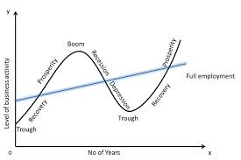
THE BUSINESS CYCLE

Slide 33
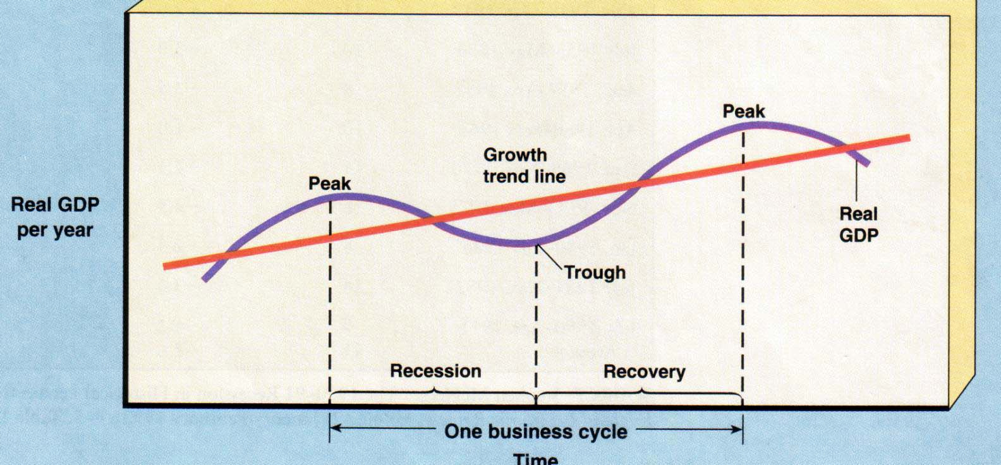
THE BUSINESS CYCLE
Inflation
Unemployment
Full employment
A recession is 6 month period of decline in output, income, employment, and trade. (If really bad…then depression)

Slide 34
four phases of the business cycle:
Expansion / Prosperity ‐ Real GDP (production) growing and unemployment rate usually falls.
Peaks / Boom ‐ Highest point of expansion. Economists can only measure once contraction begins.
Recession ‐ Real GDP (production) decreases for 6 consecutive months; unemployment rate usually increases. An extended recession is called a depression.
Troughs ‐ Lowest point of the recession. Economists can only measure once expansion / recovery / revival begins.

Slide 35
Review question
All of the following are parts of the business cycle except __________
Boom
Trough
Recession
Acceleration

Slide 36
True / false
Increasing globalization suggests that countries business cycles may be independent of one another

